Slide 1
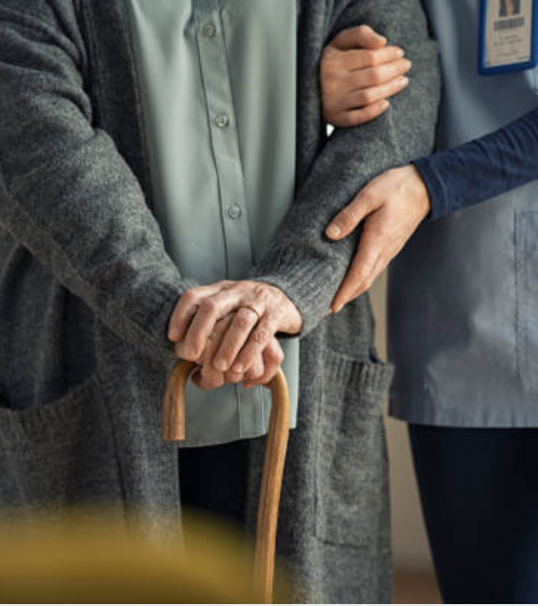
PULSE Enhancing Elderly Care Through Advanced Technology
Name : Mohammed Al Shuaili
Date : 27/01/2025
Date2 : 15/02/2025

Slide 2
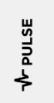
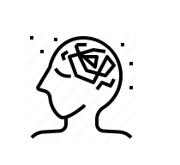



Challenges
Constant Health Concerns
Persistent concern revolves round not knowing their condition
Health Symptom Ignorance
Elderly often overlook symptoms failing to recognize the need for help
Emergency Contact uncertainty
In event of accident will they be able to reach out for help?.
Access to health care
Access to healthcare is difficult so to take preventative rather than reactive action is difficult

Slide 3
Weaknesses of Current Solutions
In home Falling Monitoring Systems
Weakness: Only alerts when patient has fallen
01
Checking in
Weakness: Unreliable - patient is not always near phone
02
Wearable devices
Weakness: Reactive - Only alerts when problems have already arisen
03

Slide 4
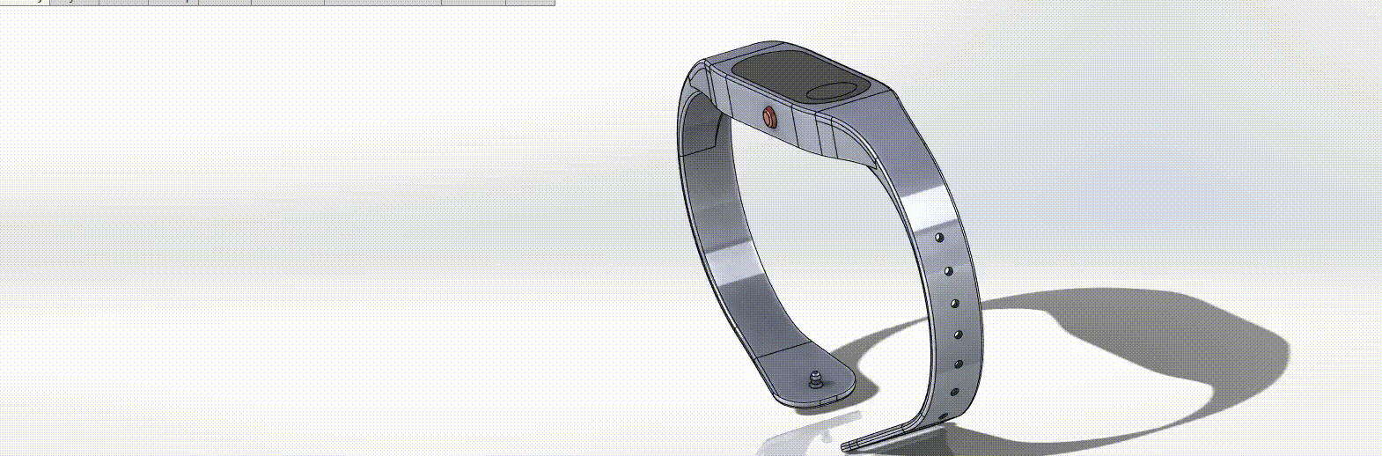

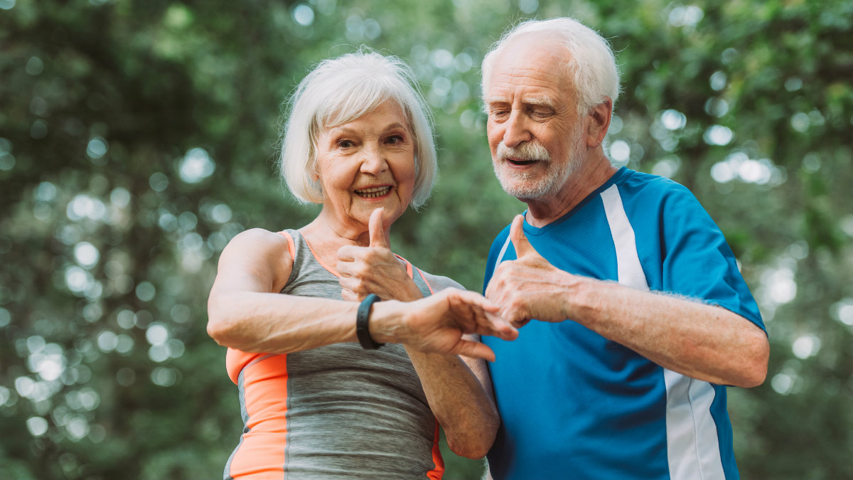
My Solution
Real-time health monitoring wearable technology.
Using:
AI
5G
And sensors
This will solve the challenges to prevent and predict healthcare issues within the elderly demographic.

Slide 5
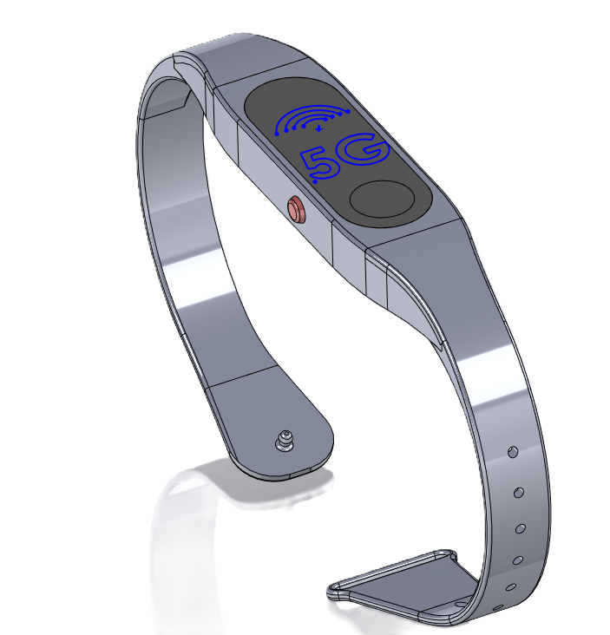
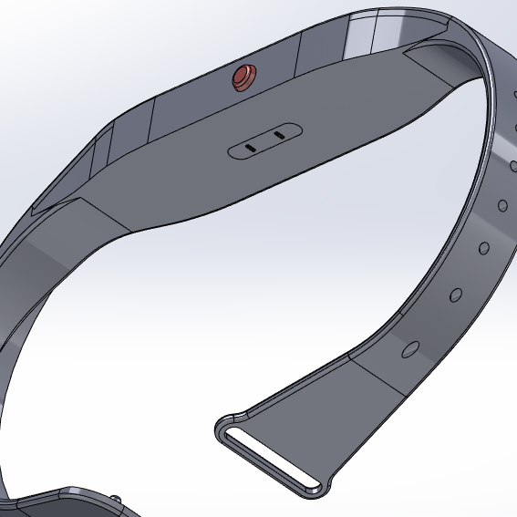
Technology Overview My solution
AI Algorithms
Analyzing data over time helps predict future health issues and generate personalized alerts.
This solution utilities technology that already exists in other products.
Sensors
Collect data from sensors such as heart rate, temperature ext.
5G
5G ensures real-time data transmission to the caregiver's phone for instant visualization.

Slide 6
GRPI Framework
Goals: Provide real-time health monitoring for elderly people using AI, 5G, and wearable sensors.
Roles: Team members include developers, healthcare consultants, and business strategists.
Processes: Data collection via sensors, real-time analysis through AI, and alert-based healthcare response.
Interactions: Healthcare providers, elderly users, family members, insurance companies, and regulatory bodies.

Slide 7
AS-IS & Desired State
AS IS | DESIRED STATE
- Elderly individuals often fail to recognize symptoms. - Uncertainty in emergency contact availability. - Limited access to proactive healthcare. | - Continuous real-time monitoring of health vitals. - AI-driven alerts predicting potential health risks. - Seamless access to healthcare interventions via connected caregivers.

Slide 8
Stakeholder Identification & Roles
Who are the stakeholders? | What are their roles ? ARMI
Project Manager - Mohammed Al Shuaili Software Developers - Brenden Kenedy and James O'Connor Healthcare Consultant - Dr. Claire Murphy Marketing & Outreach - Sarah Kennedy End Users (Elderly Individuals & Caregivers) | Oversees project execution, ensures alignment with goals, and approves major decisions (A: Approver). Responsible for developing the AI algorithms and integrating them with 5G and sensor technology (R: Resource, M: Team Member) Provides medical insights to ensure the accuracy and reliability (R: Resource, I: Keep Informed) Identifies market opportunities (M: Team Member, I: Keep Informed) Their feedback is essential (I: Keep Informed)

Slide 9
Stakeholder Analysis
Name | _ _ | _ | o | + | ++ | Action Plan
Mohammed Al Shueili |  |  |  | ❌ | ✔ | Increase strategic decision-making focus.
Brenden Kenedy and James O'Connor |  |  | ❌ | ✔ |  | Provide training on AI and 5G integration.
Dr. Claire Murphy |  | ❌ |  | ✔ |  | Involve in more frequent consultations.
Sarah Kennedy |  |  | ❌ |  | ✔ | Share advanced business and market analysis.
John Fitzpatrick (Investor) |  | ❌ |  | ✔ |  | Share weekly updates on project progress.

Slide 10









Marketing PULSE
Social Media
Using targeted ad on Facebook, Instagram ext. These ads can target our demographic of carers and family members
Social Media
Partnerships
Partnerships
Collaborations with healthcare providers, charities for the elderly
Marketing
PR
Engaging with media outlets to share successful stories about the effectiveness and positive outcomes of the system
PR

Slide 11
Project Charter (First Pass)
Purpose: Enhance elderly care using AI, 5G, and wearable technology for real-time health monitoring.
Scope: Implement wearable sensors, AI-based analytics, and real-time alerts for caregivers.
Objectives:
- Provide continuous health tracking
- Reduce emergency response time
- Improve predictive healthcare insights
Stakeholders: Elderly individuals, caregivers, healthcare providers, insurance companies, regulatory bodies.

Slide 12
DEFINE Phase (First Pass)
Problem Statement:
Elderly individuals often ignore health symptoms, have difficulty accessing healthcare, and face uncertainty in emergencies.
Opportunity Statement:
By leveraging AI, 5G, and wearable sensors, real-time health monitoring can improve elderly care and emergency responsiveness.
Project Goals:
- Implement a real-time health tracking solution
- Enhance early detection of health issues
- Improve response time to medical emergencies

Slide 13
MEASURE Phase (First Pass)
Establishing Current Performance:
- Define key health metrics (heart rate, temperature, etc.)
- Set up real-time data collection using 5G
- Measure baseline health patterns from initial users
Data Collection & Analysis:
- Use AI algorithms to analyze patterns and predict anomalies
- Compare real-time data against standard health indicators
- Assess variation and define performance benchmarks

Slide 14
THANK YOU!

